Slide 1

Mini Stereo Digital Audio Processor
Presented By:
Uday Teja Bandaru (UTB220000)
Kodanda Rama Yaswanth Kumar Ramadugu (KXR230001)
Aditya Bhaskaran (AXB230073)
Program: Computer Engineering (MS)
Date: 05/05/2025
Notes:
Good morning, My name is Kodanda Rama Yaswanth Kumar Ramadugu, and I am currently pursuing my Master’s in Computer Engineering.
Today, I will be presenting on 'CRYSTALS-Dilithium: A Lattice-Based Digital Signature Scheme.' This topic is particularly relevant in the field of post-quantum cryptography, where the focus is on creating secure systems in the face of emerging quantum technologies.

Slide 2
Applications of MSDAP
Portable audio devices (MP3 players, hearing aids, wearables)
Bluetooth headsets and wireless earbuds
Smartphones and tablets (DSP for audio enhancement)
Voice-controlled IoT devices (noise suppression, echo cancellation)Automotive infotainment and stereo systems

Slide 3
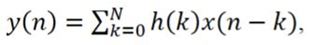
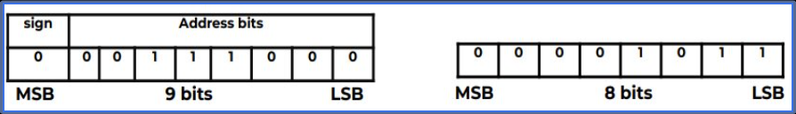
CONVOLUTION AND MSDAP ALGORITHM
OPTIMIZING THE ALGORITHM FOR POWER AND AREA:
Data Format:

Slide 4
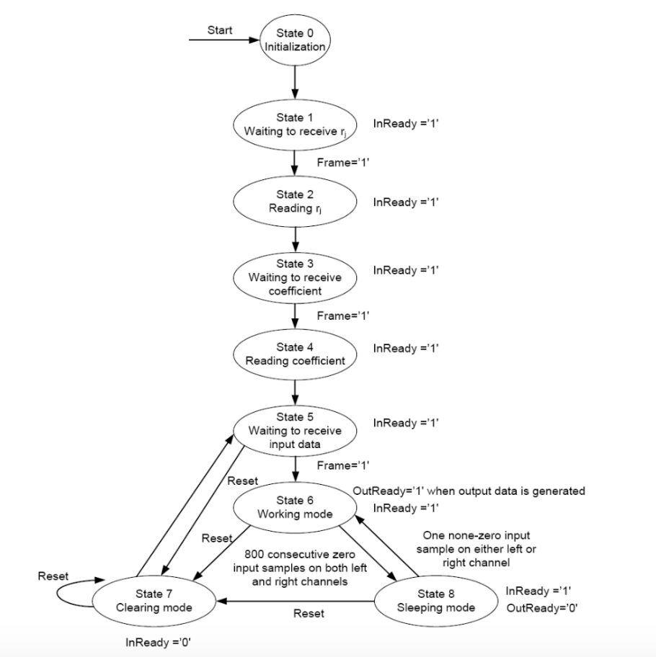
Main Controller

Slide 5
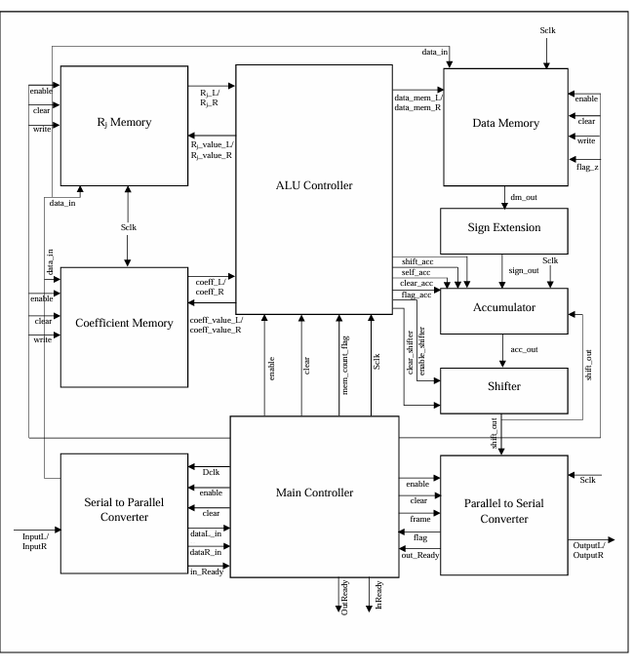
MSDAP Architecture(Original):

Slide 6
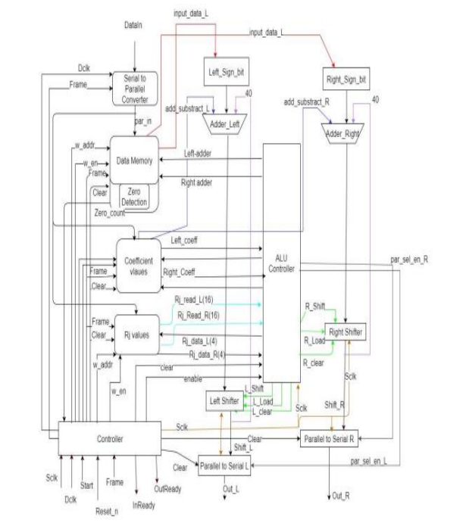
MSDAP Architecture(Updated):

Slide 7
Architecture breakdown
1. Main Controller:
Receives control signals such as:
Clock signals (CLK, SCLK) for synchronization.
Start (START) & Reset (RESET) signals to control execution.
Frame & Address signals for memory access.
Generates control signals for different processing blocks.

Slide 8
2. Memory Units:
S2P (Serial-to-Parallel) Converter - Converts incoming serial input data into parallel format.
Register File (Ri 16x16) - Temporary storage for intermediate values.
Coefficient Memory (COEFF 16x512) - Stores coefficient values required for calculations.
FIFO Data Memory (10x256) - Buffers input data.
3. ALU Controller:
Manages arithmetic operations, including:
Sign Control
Shift Control
Load Control
Reset Handlin

Slide 9
Specifications
Clock Frequencies
Sclk: 26.88 MHz (system clock for computation and control)
Dclk: 768 kHz (data clock for input/output, 16 bits per frame, frame rate = 48kHz).
Data Format
Input/Output: 16-bit 2’s complement, MSB first, serial over 16 Dclk cycles.
Rj: 8-bit values, zero-padded to 16 bits.
Coefficients (uj): 8-bit values with a sign bit, zero-padded to 16 bits.

Slide 10
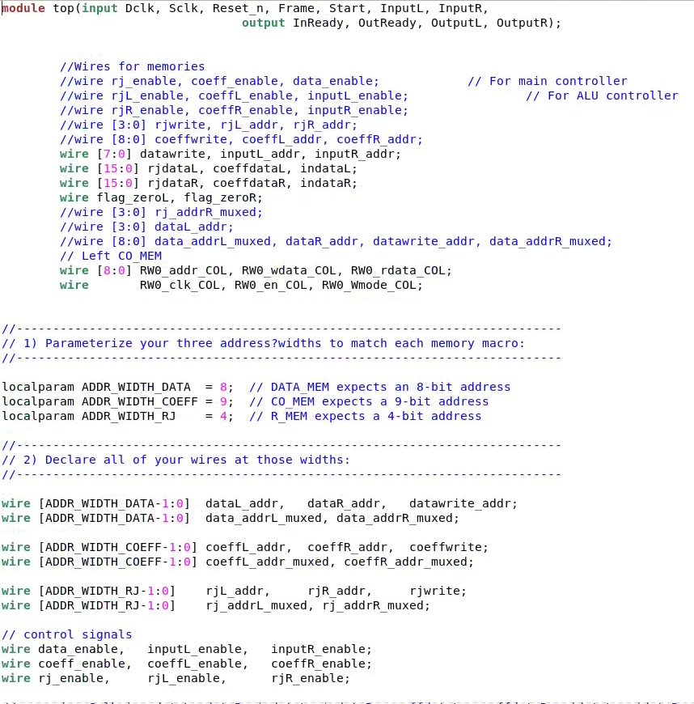
Module level Verilog
Top Level Verilog Code:

Slide 11
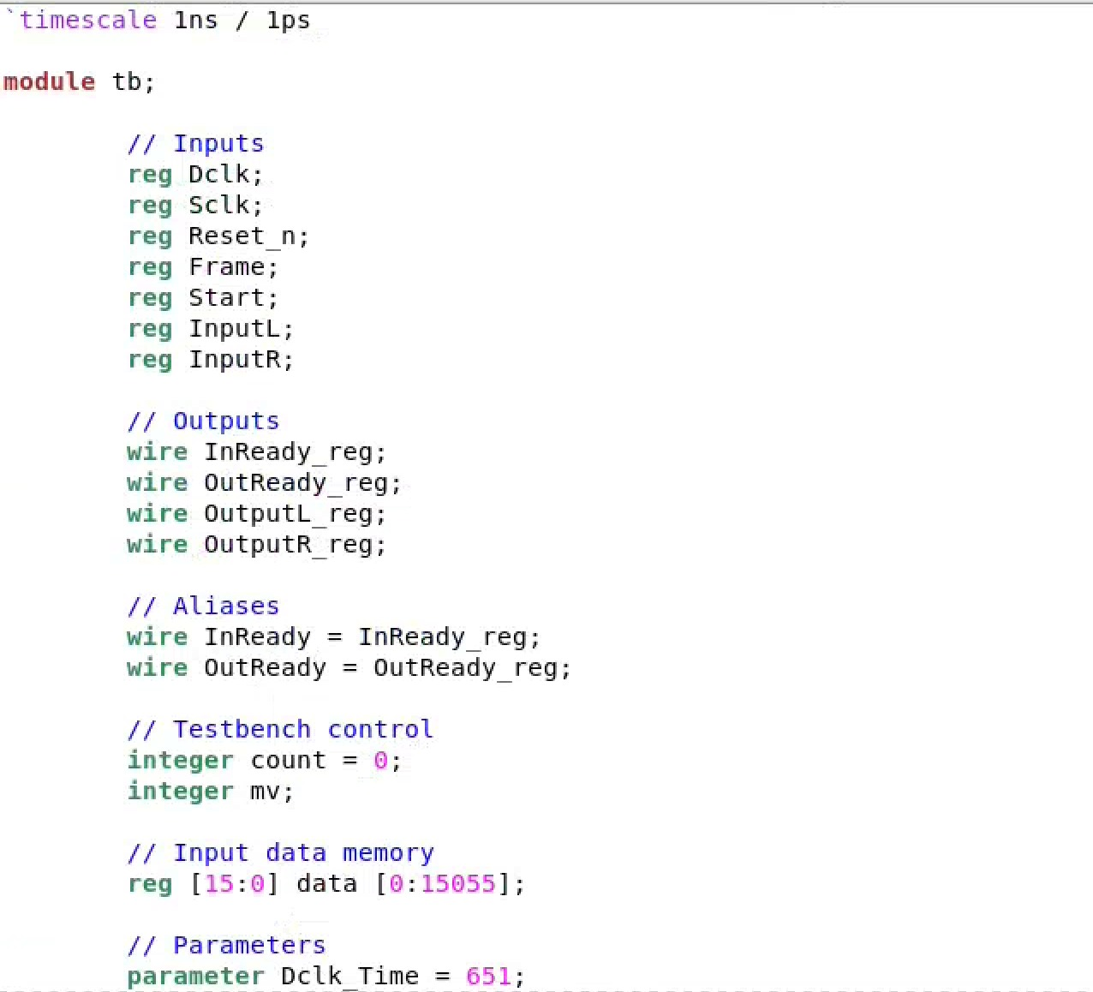
Top Level Testbench Code:

Slide 12
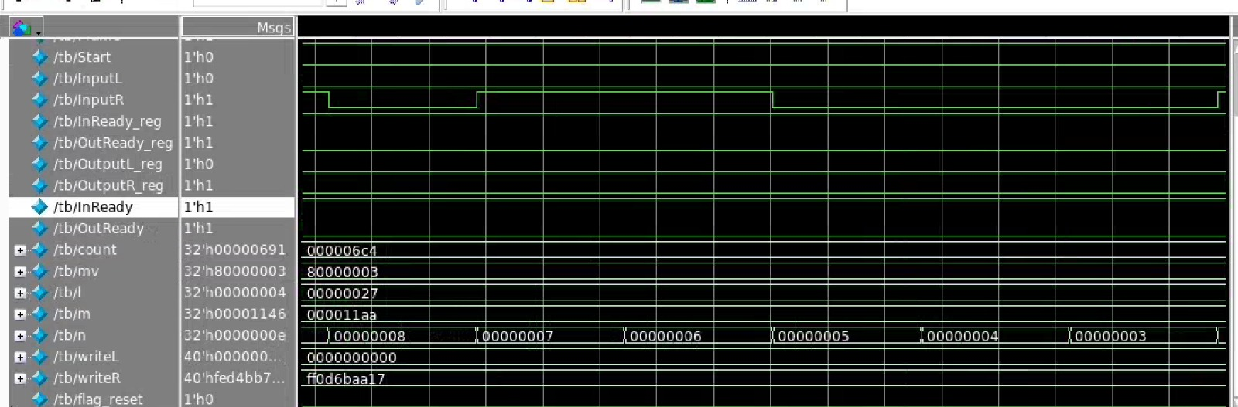
Output Waveform

Slide 13
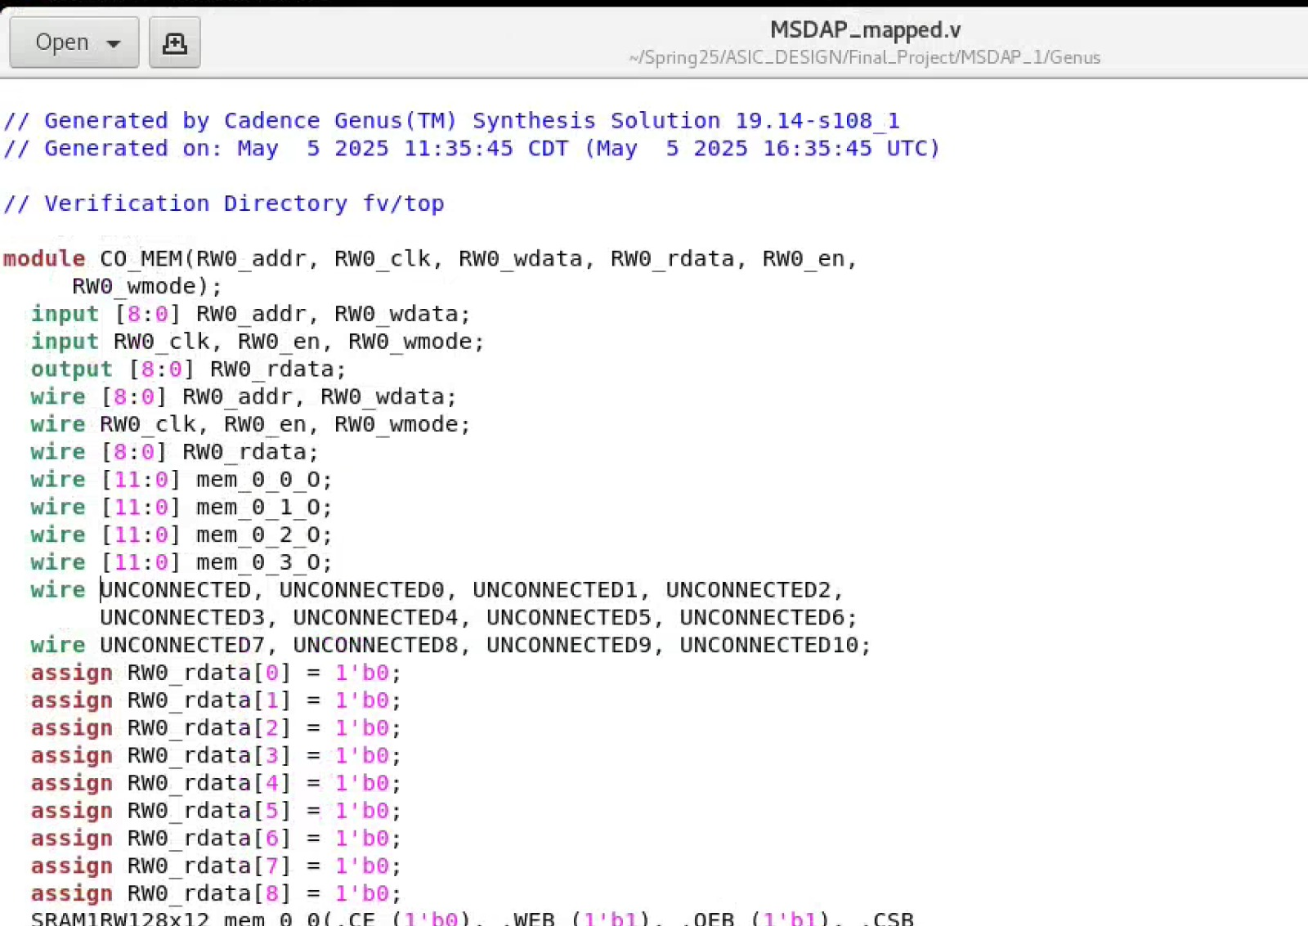
Genus Generated MSDAP Mapped.v

Slide 14
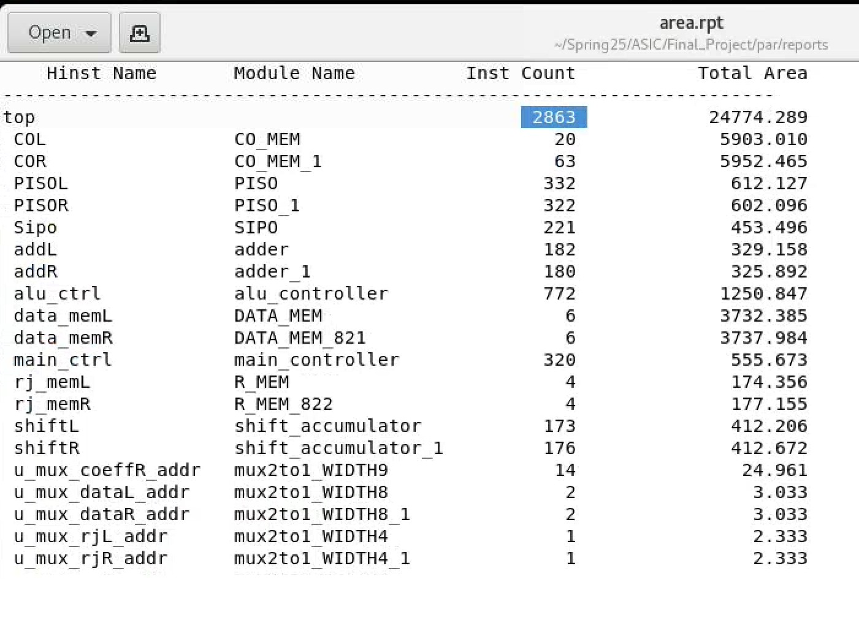
Synthesized Design

Slide 15
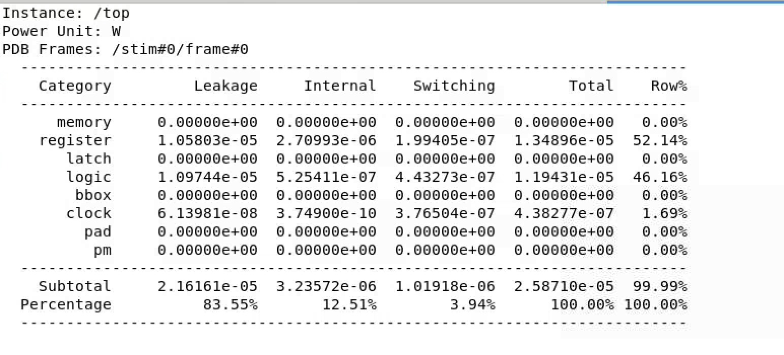
Genus Power Report

Slide 16
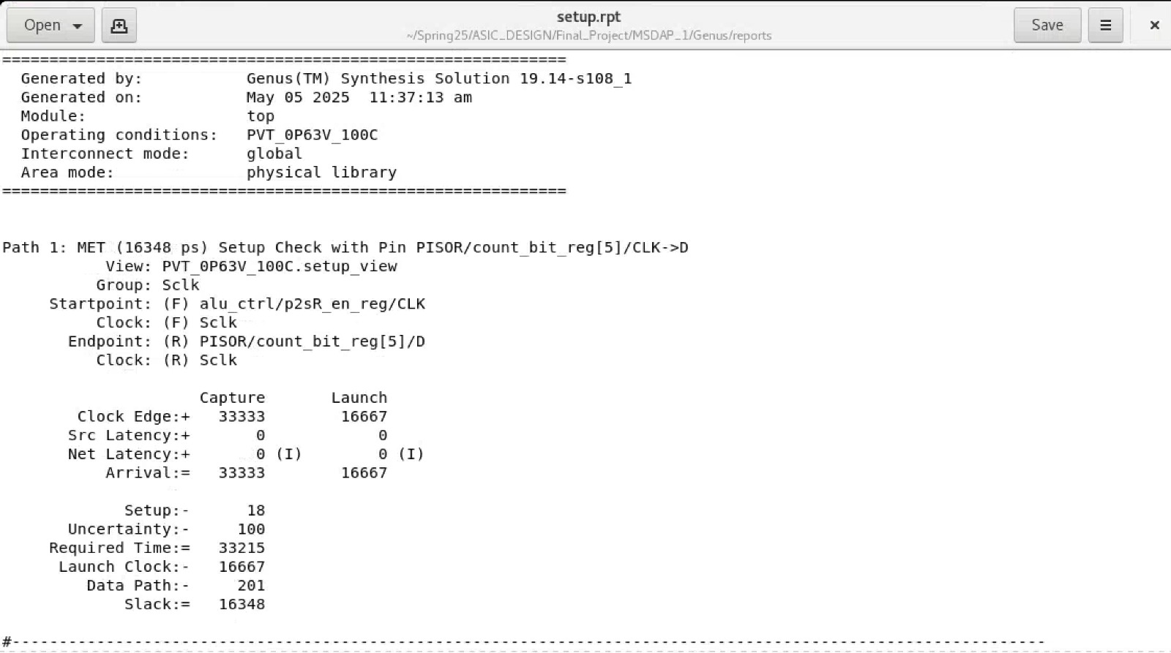
Genus Setup Report

Slide 17
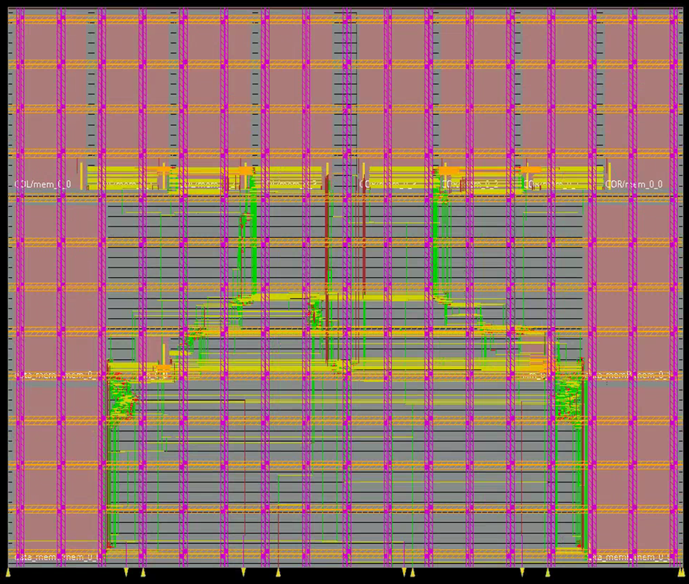
Layout

Slide 18
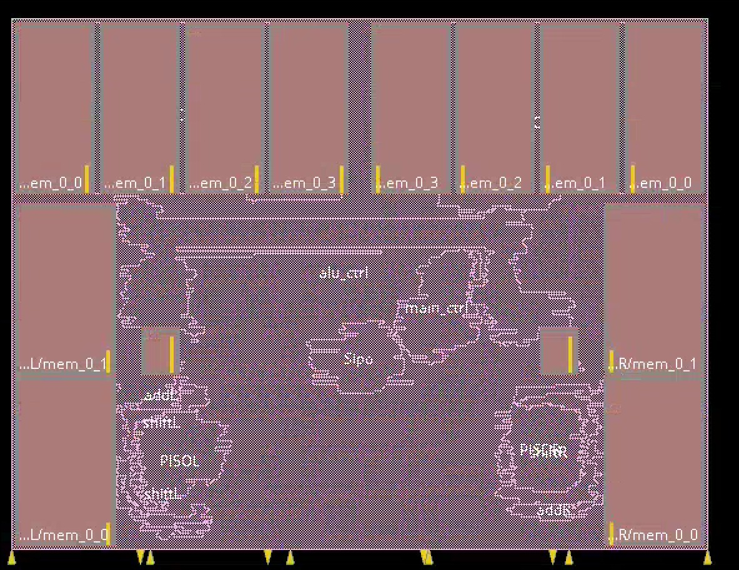
Amoeba View

Slide 19
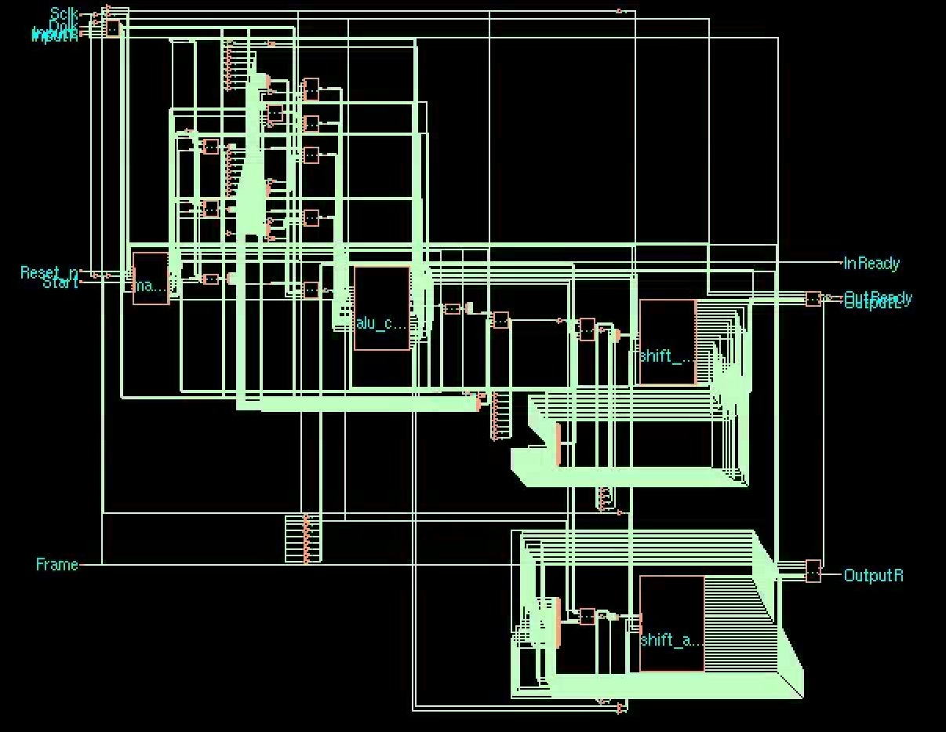
Schematic

Slide 20
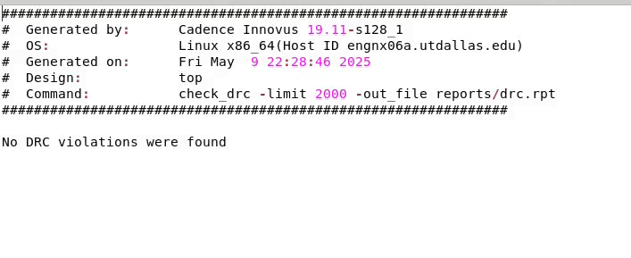
DRC

Slide 21
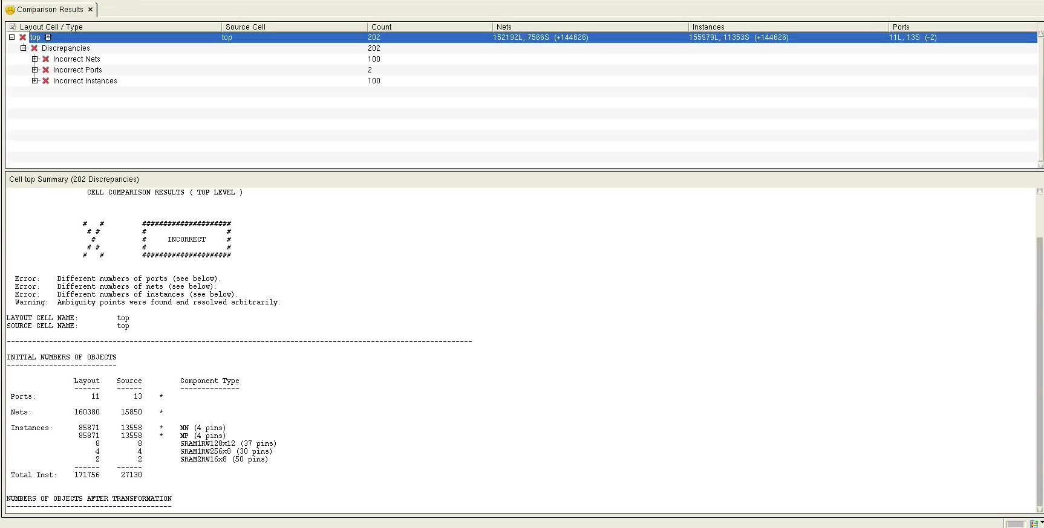
LVS Check

Slide 22
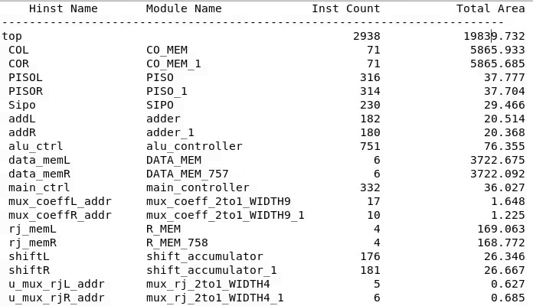
Innovus Area Report

Slide 23
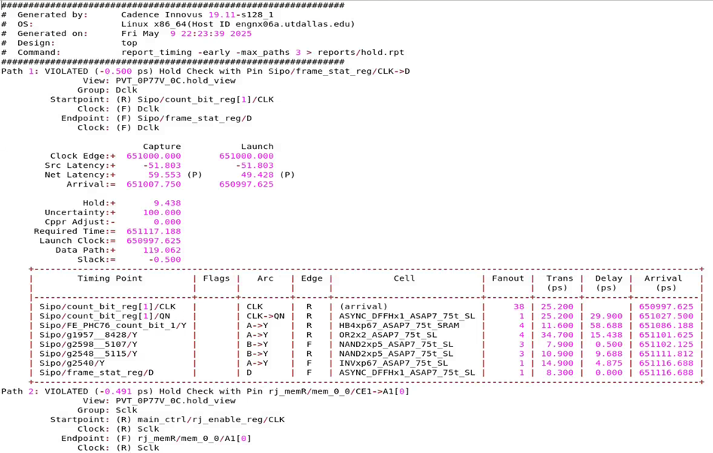
Innovus Hold Report

Slide 24
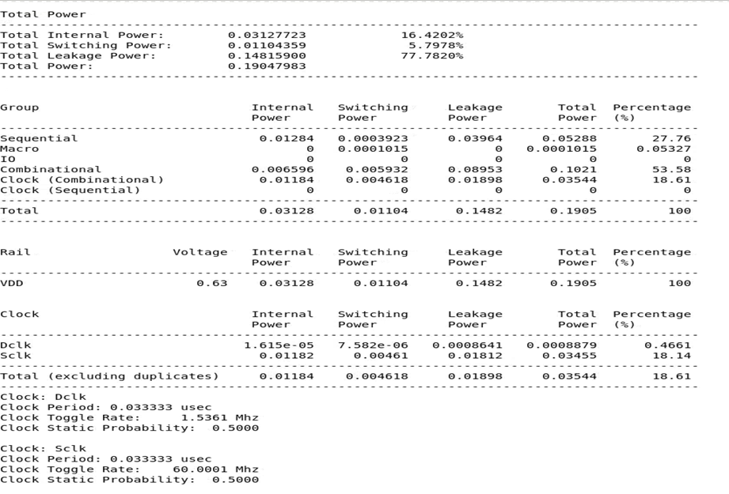
Innovus Power Report

Slide 25
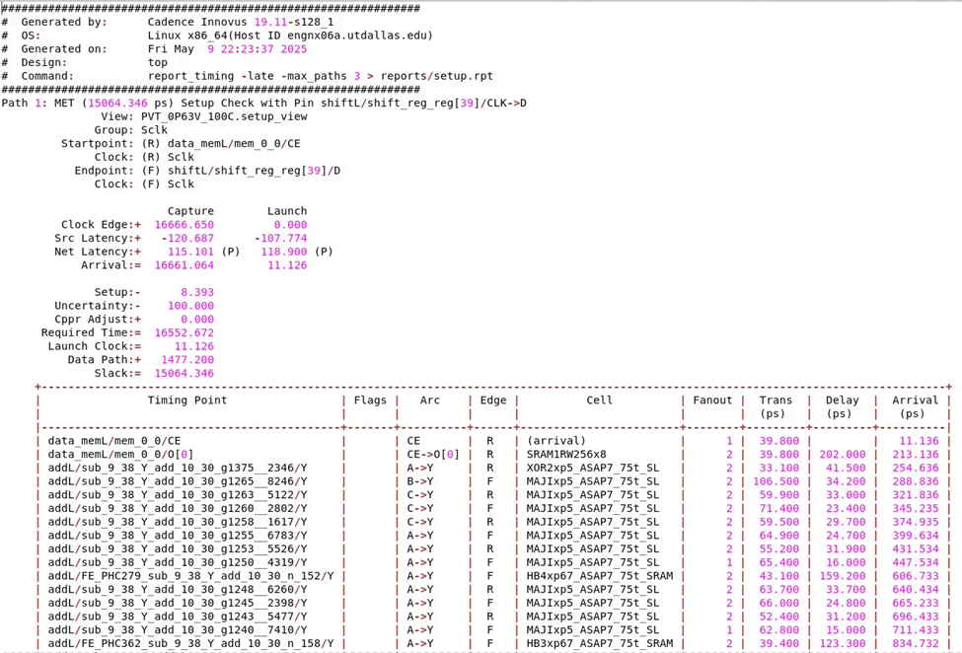
Innovus Setup Report

Slide 26
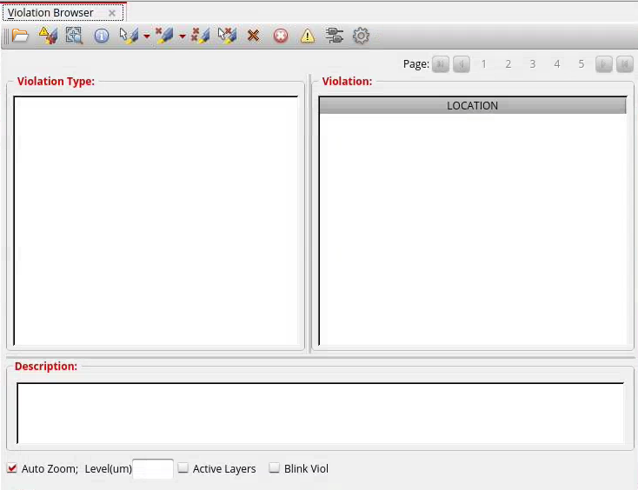
DRC Check

Slide 27

Thank You

